Slide 1

JAYAMUKHI INSTITUTE OF TECHNOLOGICAL SCIENCES
MINI PROJECT ON
VEHICLE PLATE DETECTION WITHOUT HELMET ON ROADS
TEAM MEMBERS:
G.VARA PRASAD
K.SANKEERTH
K.SAM ANUGRAH
K.CHANDER
GUIDE:
G.PANDU KRISHNA,
ASSISTANT PROFFESOR

Slide 2



ABSTRACT
Our project “number plate detection without helmet” is the application for traffic surveillance, this is an essential component. pre-processing, feature extraction, and classification are the steps we propose to do. we use traffic surveillance photographs to explain our ideas. when all is said and done, our algorithm will determine whether or not the subject is donning a helmet. a cnn model was created for the purpose of detecting helmets and license plates in various photos as part of this research .classification and clustering are used to identify helmets.

Slide 3

CONTENTS
INTRODUCTION
OBJECTIVE
IMPLEMENTATION
SYSTEM ARCHITECTURE
models
UML DIAGRAMS
RESULTS
SCOPE
CONCLUSION

Slide 4
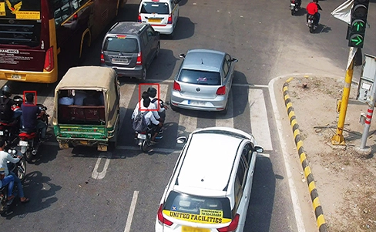
INTRODUCTION
Due to the lack of safeguards, there is a significant danger associated. the wearing of a helmet by bike riders can significantly lessen the risks they face on the road. because of the importance of wearing a helmet, governments have made it a crime to ride a bike without one, and they've implemented enforcement measures including random checks and other manual methods to detect those who do. in contrast, the current image-based surveillance technologies are passive and require a lot of human intervention.

Slide 5
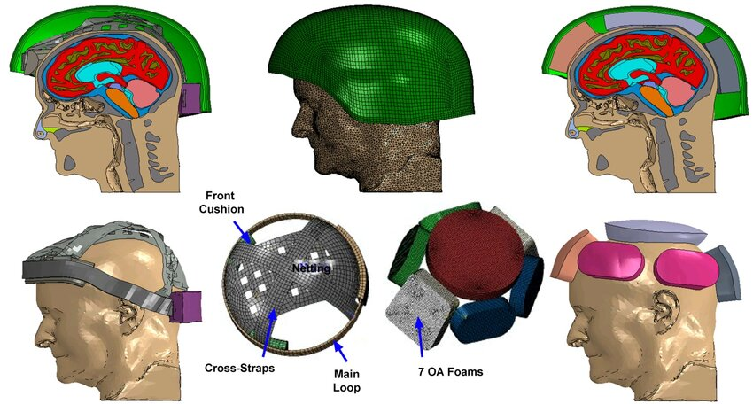
OBJECTIVE
Helmet reduces the chances of skull getting decelerated, hence sets the motion of the head to almost zero. injuries can be minimized if a good quality full helmet is used. manual surveillance of traffic using cctv is an existing methodology. but here so many iterations have to be performed to attain the objective and it demands a lot of human resource. so here we propose a methodology for full helmet detection and license plate extraction using yolov2, yolov3 and ocr.

Slide 6
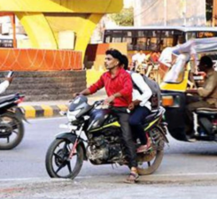
EXISTING SYSTEM
Existing system monitors the traffic violations primarily through cctv recordings, where the traffic police have to look into the frame where the traffic violation is happening, zoom into the license plate in case rider is not wearing helmet. but this requires lot of manpower and time as the traffic violations frequently and the number of people using motorcycles is increasing day-by-day.

Slide 7
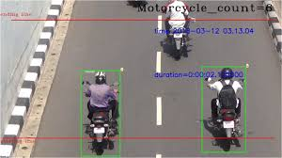
PROPOSED SYSTEM
In this project we are detecting whether two wheeler rider wearing helmet or not, if he is not wearing helmet then we are extracting number plate of that two wheeler. To extract number plate we have YOLO CNN model with some train and test images .

Slide 8
To implement above technique we are following or implemented below modules
First image will be upload to the application and the using YOLOV2 we will check whether image contains person with motor bike or not, if YOLO model detect both person and motor bike then we will proceed to step 2.
In this module we will use YOLOV3 model to detect whether object wear helmet or not, if he wear helmet then application will stop hear itself. If rider not wear helmet then application proceed to step 3.
In this module we will extract number plate data using python tesseract OCR API. OCR will take input image and then extract vehicle number from it.
IMPLEMENTATION

Slide 9
The modules involved in this project are:
Upload image
Detect motor bike &person
Detect Helmet

Slide 10
SYSTEM ARCHITECTURE
Reference image
Feature extraction
Feature matching
This is a system for detecting whether or not someone is wearing a helmet and reading their license plate based on photos obtained from a traffic monitoring system and fed into convolutional neural networks.
Person without Helmet
Person with Helmet
Number plate detection
System Architecture

Slide 11
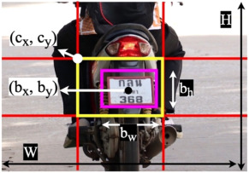
models
The proposed system for automatic helmet detection and number plate recognition using the yolov3 algorithm. the system aims to enhance safety and security by accurately detecting helmets worn by motorcyclists and recognizing the number plates of vehicles in real time.

Slide 12
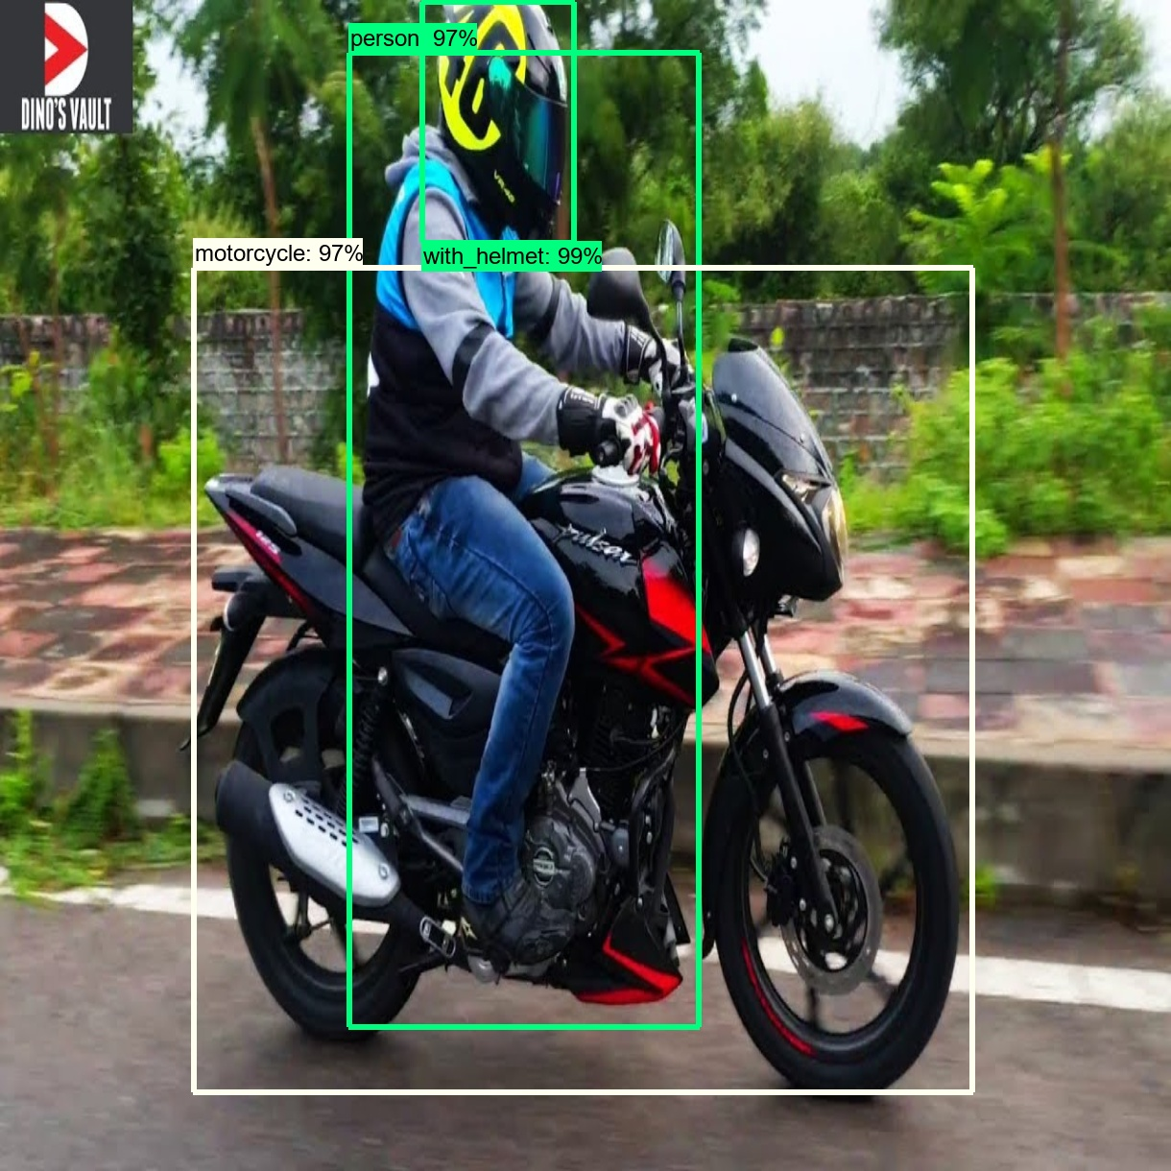
Helmet Detection
The helmet detection component utilizes the YOLOv3 model, which has been fine-tuned using a diverse dataset of annotated images and videos. Through this process, the model has learned to identify and localize helmets in real-world scenarios.

Slide 13
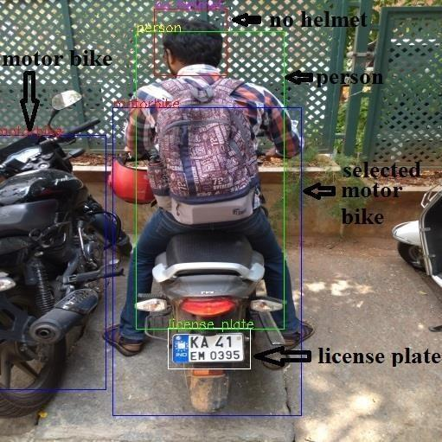
Number Plate Recognition
Optical character recognition (OCR) algorithms are employed to recognize and extract alphanumeric characters from the pre-processed number plate regions.

Slide 14
UML Diagrams
Upload Image
USE CASE DIAGRAM:
A use case diagram in the Unified Modeling Language (UML) is a type of behavioral diagram defined by and created from a Use-case analysis The main purpose of a use case diagram is to show what system functions are performed for which actor. Roles of the actors in the system can be depicted.
Detect Motor Bike & person
user
Detect Helmet
Exit

Slide 15
CLASS DIAGRAM:
In software engineering, a class diagram in the Unified Modeling Language (UML) is a type of static structure diagram that describes the structure of a system by showing the system's classes, their attributes, operations (or methods), and the relationships among the classes. It explains which class contains information.
User
+Upload Image()
+Detect Motor Bike &Person()
+Detect Helmet()
+Exit()

Slide 16
ACTIVITY DIAGRAM:
Activity diagrams are graphical representations of workflows of stepwise activities and actions with support for choice, iteration and concurrency. In the Unified Modeling Language, activity diagrams can be used to describe the business and operational step-by-step workflows of components in a system. An activity diagram shows the overall flow of control.
User
Upload Image
Detect Motor Bike &Person
Detect Helmet
Exit

Slide 17
Experimental results
If a helmet is not present in an image, the application will identify the number plate; if a helmet is present, the application will not identify the number plate. This is because we don't have enough images to train the CNN model, so our application can detect the presence of a helmet from 25 different images

Slide 18
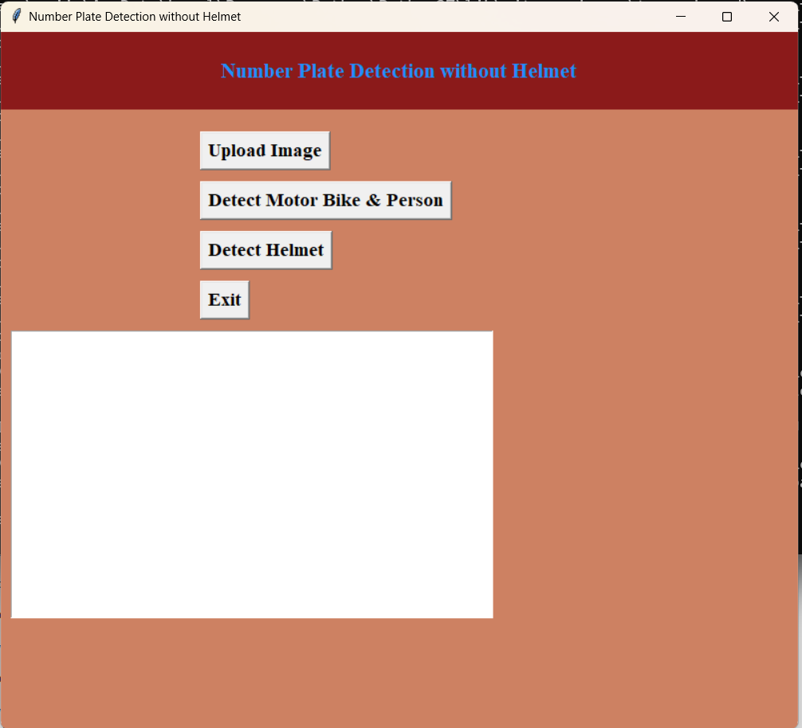
In above screen click on ‘Upload Image’ button to upload image

Slide 19
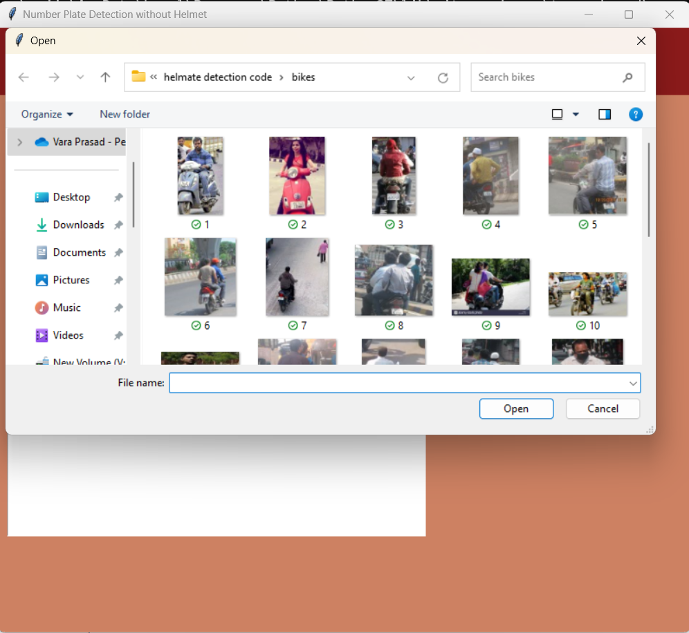
Pick and then upload the file then click on "Open," and then click on "Detect Motor Bike & Person" to determine whether or not there is an image of a someone riding a motorcycle in it.

Slide 20
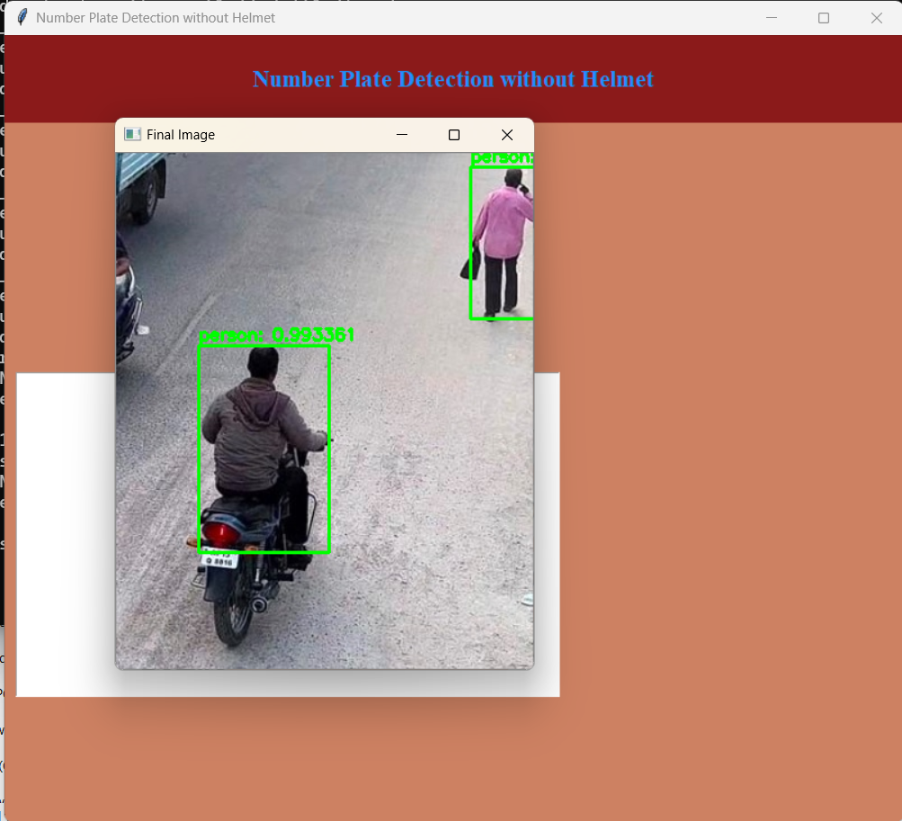
In the above screen, if a person on a bike is spotted, the 'Detect Helmet' button is pressed to get the following output.

Slide 21
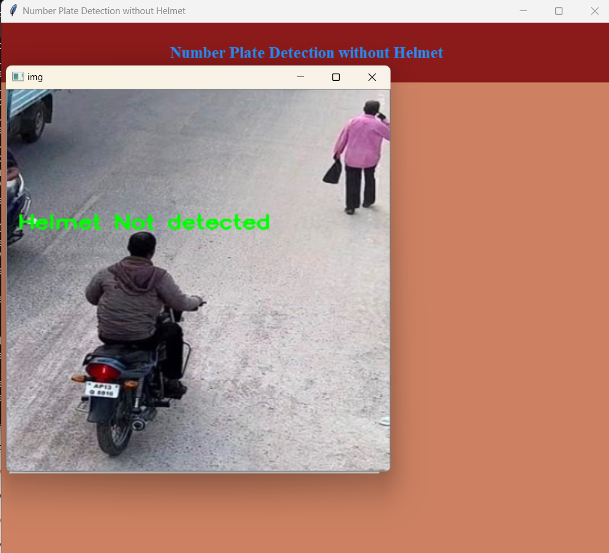
We can see that the helmet is not identified in the screen shot above.

Slide 22
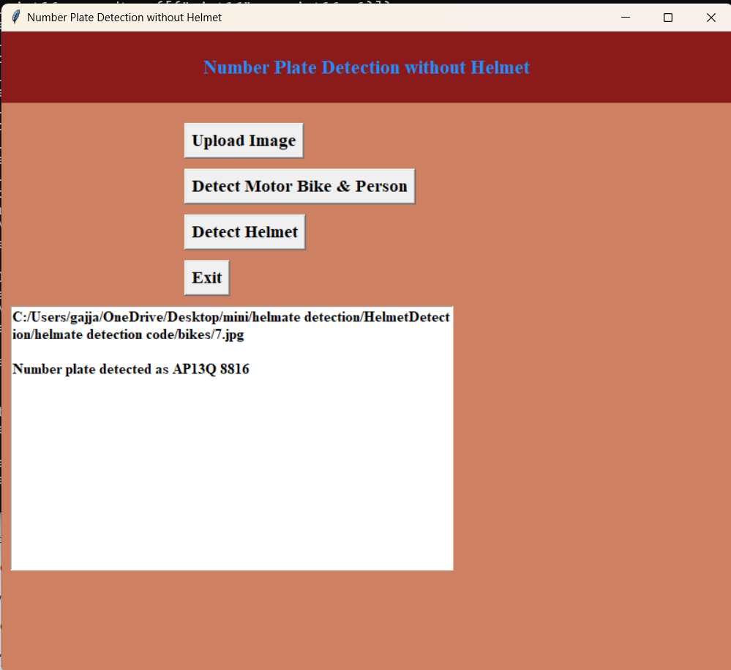
The application then identifies the license plate number and displays it as ‘AP13Q8816 in the text box.

Slide 23
Future scope
Video frames will be used in the future to extend this notion. we can even recognize the number plate without the helmet quite effectively through films.

Slide 24
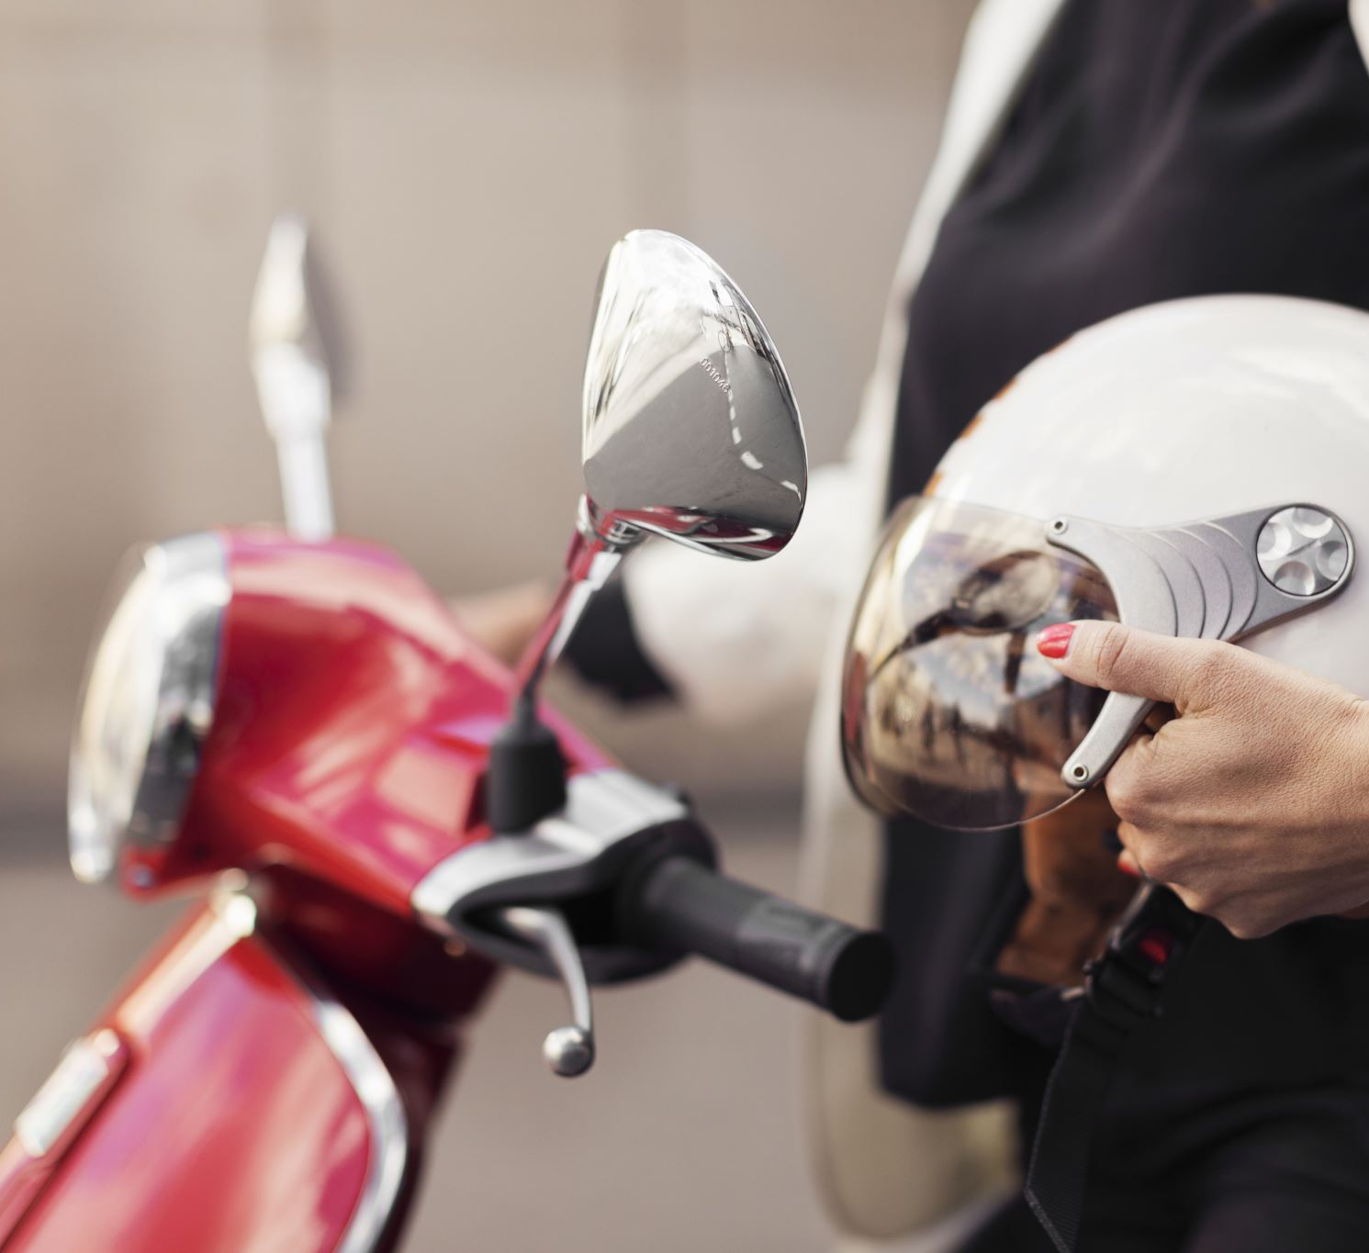
Conclusion
A non-helmet rider detection system is developed where a video file is taken as input. if the motorcycle rider in the video footage is not wearing helmet while riding the motorcycle, then the license plate number of that motorcycle is extracted and displayed. object detection principle with yolo architecture is used for motorcycle, person, helmet and license plate detection. ocr is used for license plate number extraction if rider is not wearing helmet. not only the characters are extracted, but also the frame from which it is also extracted so that it can be used for other purposes. all the objectives of the project is achieved satisfactorily.

Slide 25

THANK YOU

